Slide 1
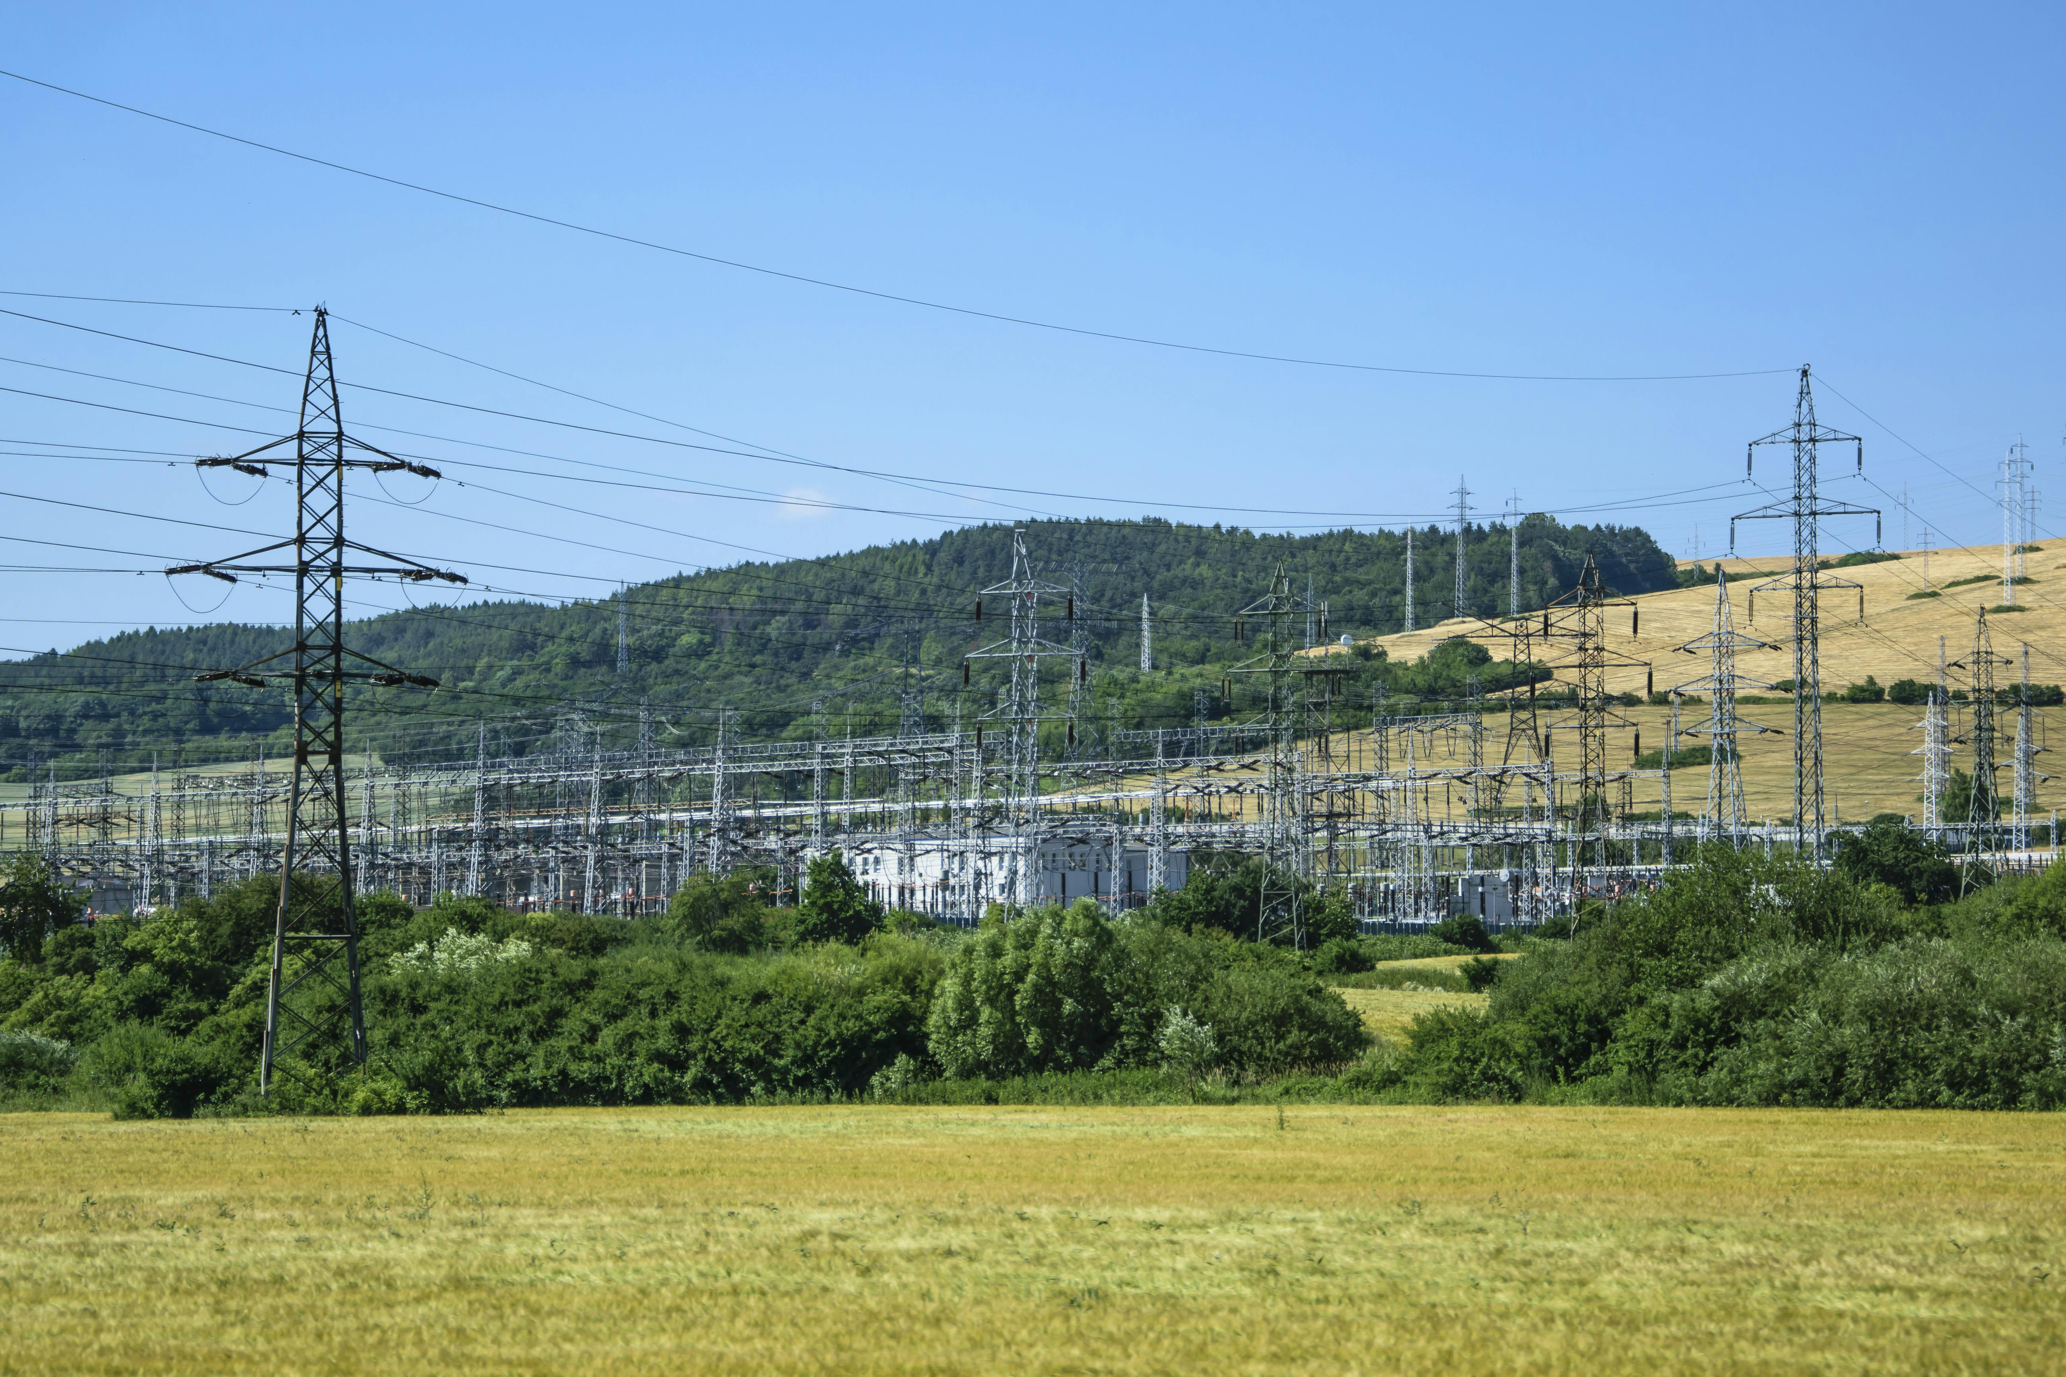


Performance Based Regulation (PBR)
STAKEHOLDER WORKGROUP MEETING #7
Virginia Department of Energy
Glenn Davis
Director
Virginia Department of Energy
Larry Corkey
Manager, Policy and Planning
Virginia Department of Energy
Jonika Rathi
Research Analyst
Virginia Department of Energy
April 10th 2025

Slide 2



Stakeholder group
Advanced Energy United
Appalachian Power
Appalachian Voices
Chesapeake Climate Action Network
Clean Virginia
Climate Action Alliance of the Valley
Commission on Electric Utility Regulation
Current Energy Group
Data Center Coalition
Department of Energy
Department of Environmental Quality
Dominion Energy
Great Plains Institute
Office of Attorney General
Old Dominion Committee for fair Utility Rates
Natural Resources Defense Council (NRDC)
New Virginia Majority
NRG Energy
Pacific Economics Group Research LLC
Pacific Northwest National Laboratory
Plan RVA
Regulatory Assistance Project (RAP)
Rocky Mountain Institute (RMI)
Secure Solar Futures
Sierra Club Virginia Chapter
Solar United Neighbors
Southern Environmental Law Center VA
The Nature Conservancy
The Virginia Grassroots Coalition
Virginia Association of Counties
Virginia Energy Consumer Alliance
Virginia Energy Purchasing Governmental Association
Virginia Committee for Fair Utility Rates
Virginia League of Conservation Voters
Virginia Manufacturers Association
Virginia Municipal League
Virginia Organizing
Virginia Poverty Law Center
SCC PBR STUDY

Slide 3
AGENDA
Meeting #6
Welcome
Current performance mechanisms in the Commonwealth – Rocky Mountain Institute (RMI)
Potential PBR Reforms – Clean Virginia & Synapse Energy
Discussion on the regulation of competitive service providers
Final comments and Exercise
Next Steps and Closing
SCC PBR STUDY

Slide 4
Current performance mechanisms in the Commonwealth
Rocky Mountain Institute (RMI)
SCC PBR STUDY

Slide 5
Pbr reform ideas
Clean Virginia and Synapse Energy
SCC PBR STUDY

Slide 6
Discussion on the regulation of competitive service providers
SCC PBR STUDY

Slide 7
Regulation of competitive service providers
HJ30/SJ47
Such study shall evaluate the potential of such tools and alternative regulatory tools to modernize the legal or regulatory framework relevant to such [investor-owned] utilities and competitive service providers.
For purposes of this resolution, "competitive service providers" means entities with generation or transmission and licensed suppliers that sell electricity to end-use customers.
SCC PBR STUDY

Slide 8
Regulation of competitive service providers
HJ30/SJ47
(a) provide an analysis of the current regulatory framework and the financial incentives such framework creates for investor-owned electric utilities and competitive service providers in the Commonwealth;
(b) identify possible misalignments between such incentives for investor-owned utilities and competitive service providers and the Commonwealth's energy policy goals;
(c) analyze performance-based and alternative regulatory tools used in other jurisdictions to correct such misalignments;
SCC PBR STUDY

Slide 9
Regulation of competitive service providers
HJ30/SJ47
(d) review the varying obligations on investor-owned utilities and competitive service providers;
(e) analyze the potential impact of competitive service providers to all customers in the Commonwealth
SCC PBR STUDY

Slide 10
Regulation of competitive service providers
What influence or incentives does the current regulatory framework provide the CSPs?
What effects on CSPs do we expect if performance-based or alternative tools discussed in these workshops are applied to regulated utilities?
What would be the challenges in applying these tools to CSPs?
How should CSP regulation relate to IOU regulation? Are there certain performance areas that, if incentivized, could create more effective dynamics between IOUs, CSPs, and the Commonwealth’s goals?
SCC PBR STUDY

Slide 11
Final comments and exercise
Discussion and Questions
SCC PBR STUDY

Slide 12
Next steps
SCC PBR STUDY

Slide 13
next steps
Timeline :
  Ongoing open public comment period until 11th April.
  PBR Assessment Exercise due on 11th April.
  Department of Energy Report to SCC due on 9th May.
SCC PBR STUDY

Slide 14
next steps
Future Meetings :
  Stakeholder Group Meeting #8 is scheduled for 22nd April from 1 pm – 4 pm
    Virginia Manufacturer's Association to present on carbon leakage
    Review the draft report
SCC PBR STUDY

